Slide 1
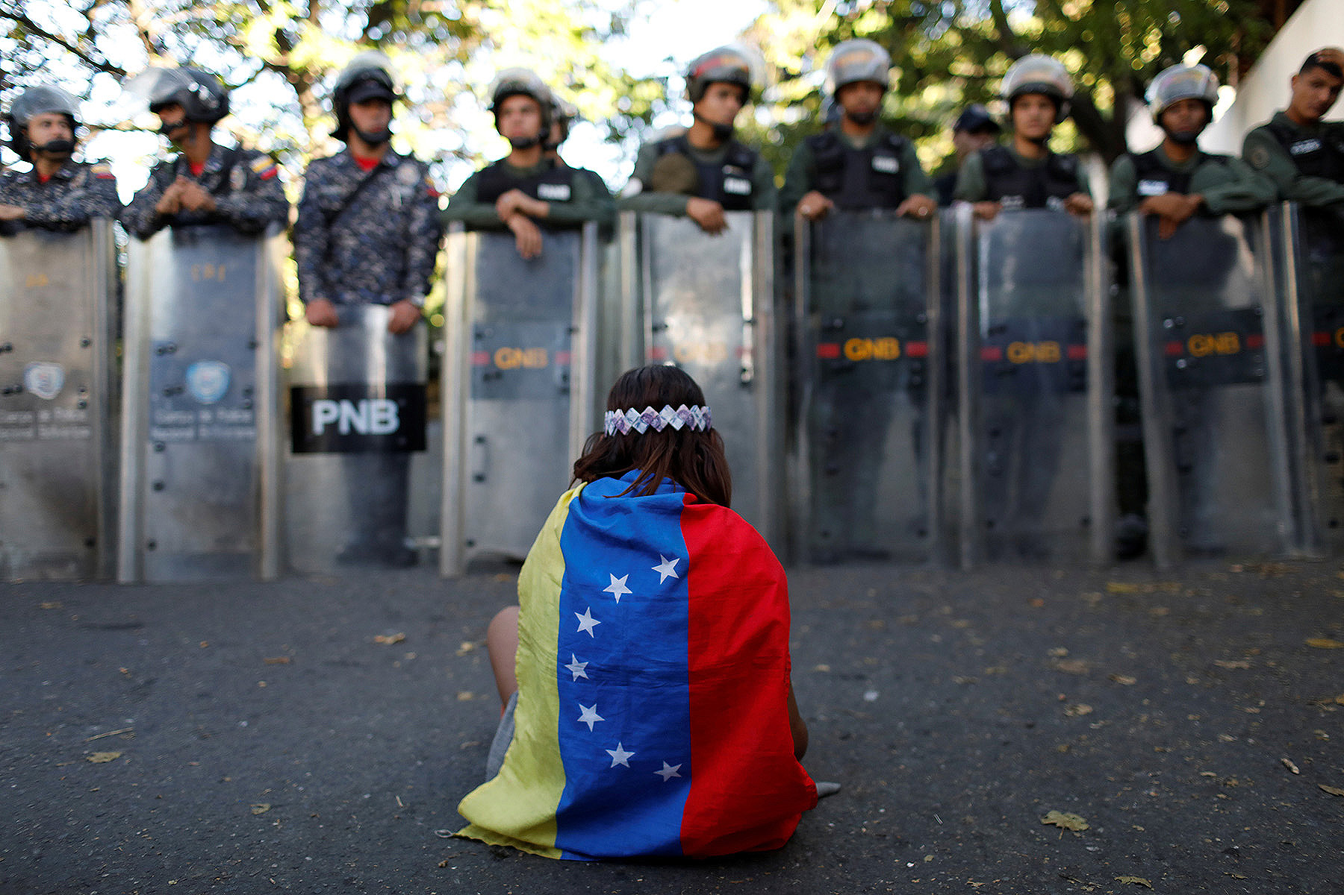


Humanitarian Crisis in Venezuela
2
+
TRACK 2 – NGO’s
Kapilesh Yang Deepak ️ Raisa

Slide 2



Slide 3

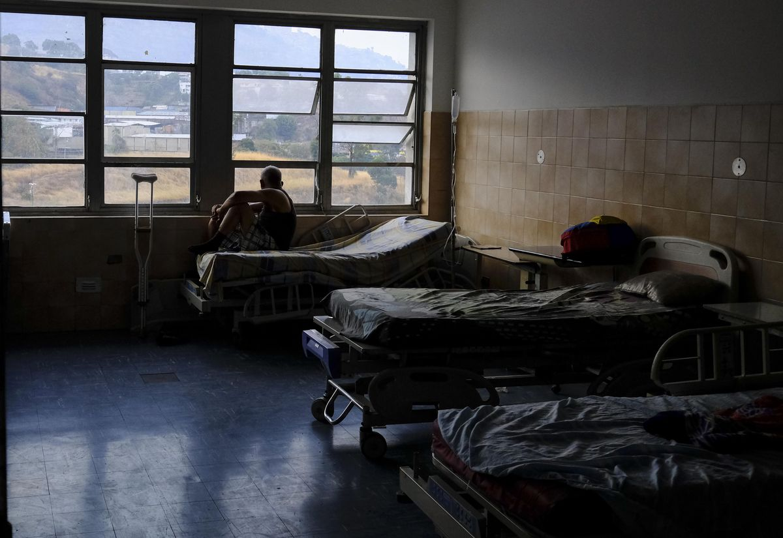
BUSINESS PROBLEM
2
+
Lack of Reliable Data
Difficulty in Allocating Resources
Notes:
We do not have enough information about the cause of death. So NGO’s will have a hard time figuring out what to give as supplies and equipment.

Slide 4
Data exploration
AND
FEATURE ENGINEERING
Identify Relevant Columns
- Areas important to invest for NGO’s
Identify Factors of criticality
- Population Density * Specific Operability
Notes:
- Operability of specific units: Describes operability of units such as emergency, pavilions, laboratories, etc.
- Supply availability in emergency: Variables in this subsection include medicines and equipment
- Supply availability for appendicitis: Variables in this subsection include medicines and supplies. Readiness for appendicitis is used to evaluate if the hospital has the basic supplies to conduct a simple medical procedure.
If they do not have these things then the resources are scarce in general.

Slide 5
2
+
Statistical Metric to judge Criticality
Population Density
Low
High
Low
Low Priority
Medium Priority
Average Scarcity of Resources
High
High Priority
MOST CRITICAL
Notes:
Most Critical Scene needs the utmost important at the moment. Because the population density is high in those areas and the scarcity of resources is also high. So they care urgently.
Similarly, we termed Low Priority to those areas where the population density is low and also less scarce resources.

Slide 6
Dashboard

Slide 7

2
+
Prepare for Stability

